Slide 1
Earthquake Intensity
E³
Using Data Science for better understanding
Eric Hepp

Slide 2
Community Decimal Intensity Usefulness
Conclusion: Based on this dataset, Community Decimal Intensity (CDI) is useful as initial evaluator; it is cheap and easy to collect data.
It can be a reasonable predictor of Modified Mercalli Intensity (MMI) when considering the maximum values of each which occur near earthquake epicenter, especially when combined with additional factors of depth and region.
CDI can be predicted from magnitude and distance when enhanced by additional non-traditional factors.

Slide 3
Intensity and Distance
Epicenter
Epicentral Distance
Depth
Hypocentral Distance
Hypocenter
Notes:
Sources:

Slide 4
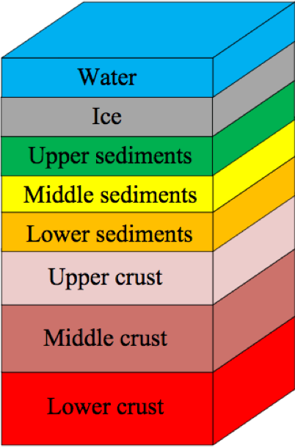
Intensity factors and Measurement
Contributing
Factors:
Magnitude
Distance
Depth
Crustal Properties
INTENSITY
GOAL: Predict it Better!
Methods to
Quantify:
Modified Mercalli (MMI)
Expert / Reviewed
May employ surface motion sensors
Modified and used in US from 1931
Community Decimal (CDI)
Crowd sourced from DYFI reports
Began 1991, in common use after 2001

Slide 5
Intensity Modeling: Validate CDI
Magnitude
Distance
Depth
Crustal Properties
INTENSITY
Modified Mercalli (MMI)
Expert / Reviewed
May employ surface motion sensors
Modified and used in US from 1931
Community Decimal (CDI)
Crowd sourced from DYFI reports
Began 1991, in common use after 2001
Model

Slide 6
Intensity Modeling: Add Detail
Magnitude
Distance
Depth
Crustal Properties
Model
INTENSITY
Modified Mercalli (MMI)
Expert / Reviewed
May employ surface motion sensors
Modified and used in US from 1931
Community Decimal (CDI)
Crowd sourced from DYFI reports
Began 1991, in common use after 2001

Slide 7
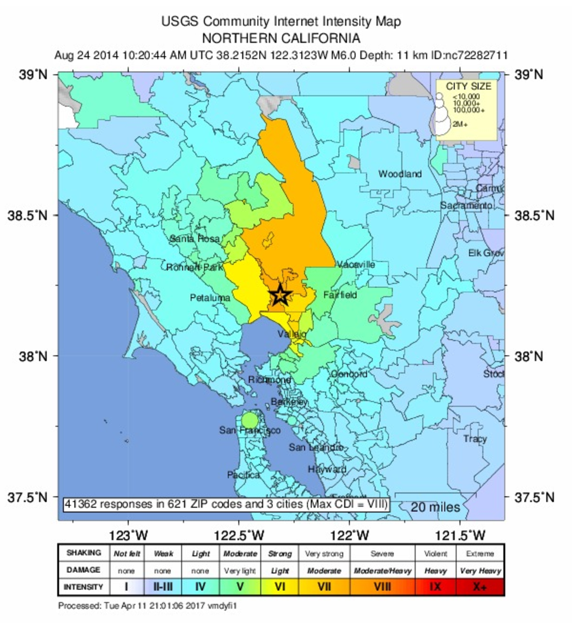
Data: How Much
Earthquakes from 1970 to mid 2017
Quakes
“DYFI” CDI
MMI
> 5
Earthquakes | Did You Feel It Intensity
117, 459
7287 | 273,499
4425 | 85,236
1206 | 55, 888

Slide 8
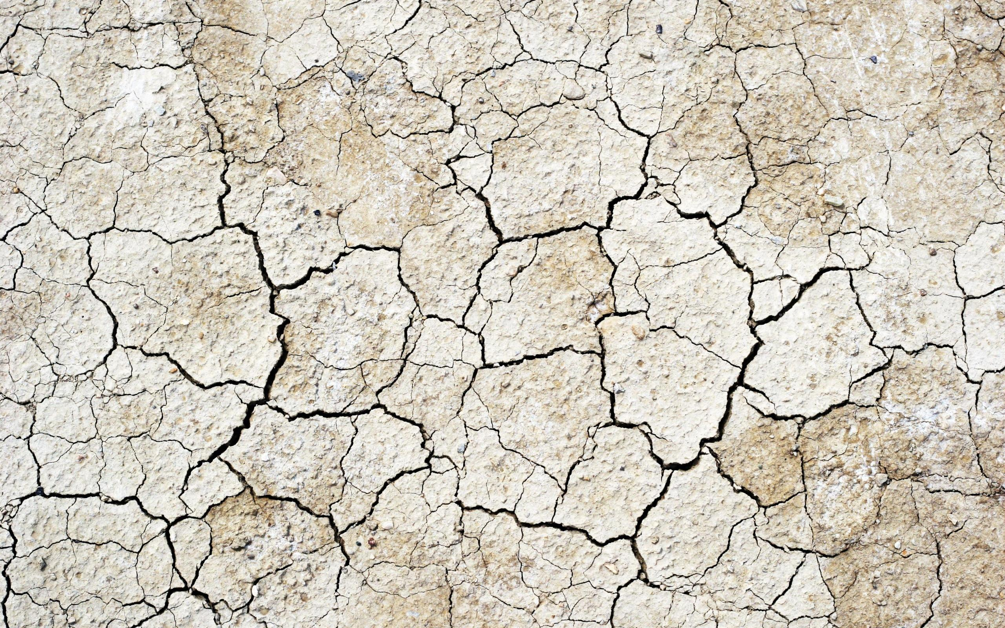
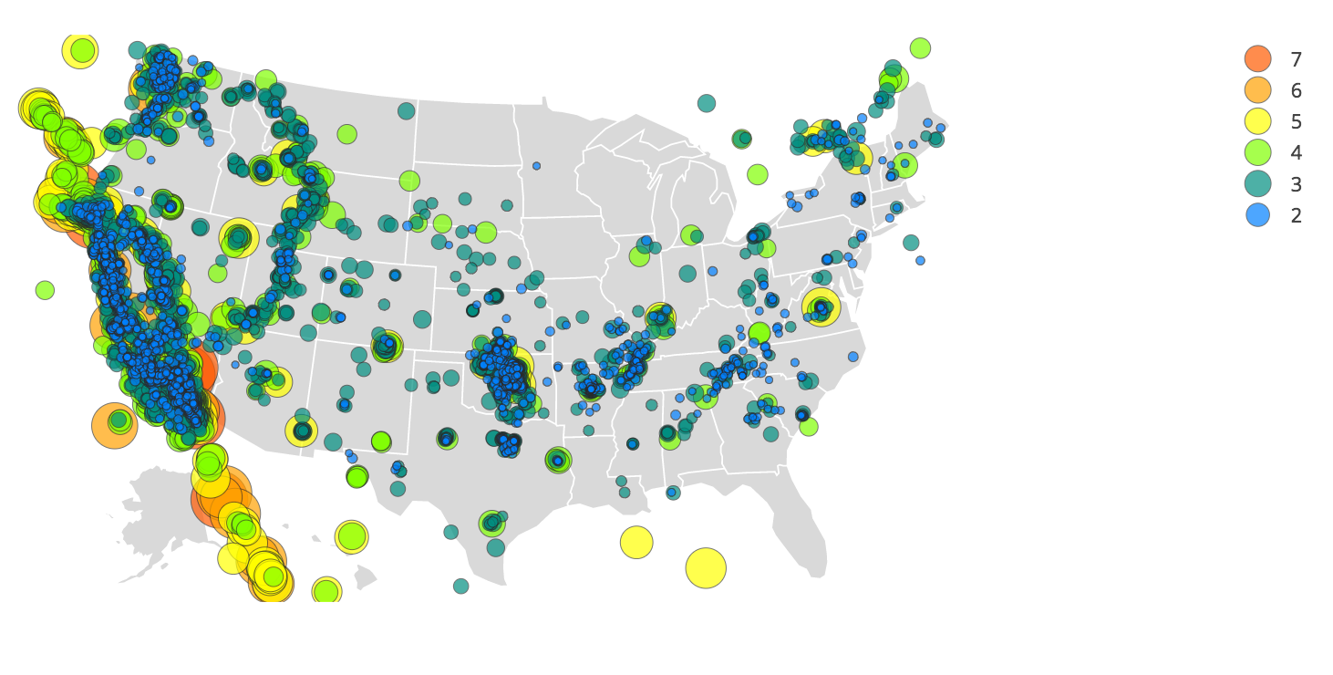
earthQuakes with DYFI / CDI data
Many small earthquakes
Few large earthquakes

Slide 9
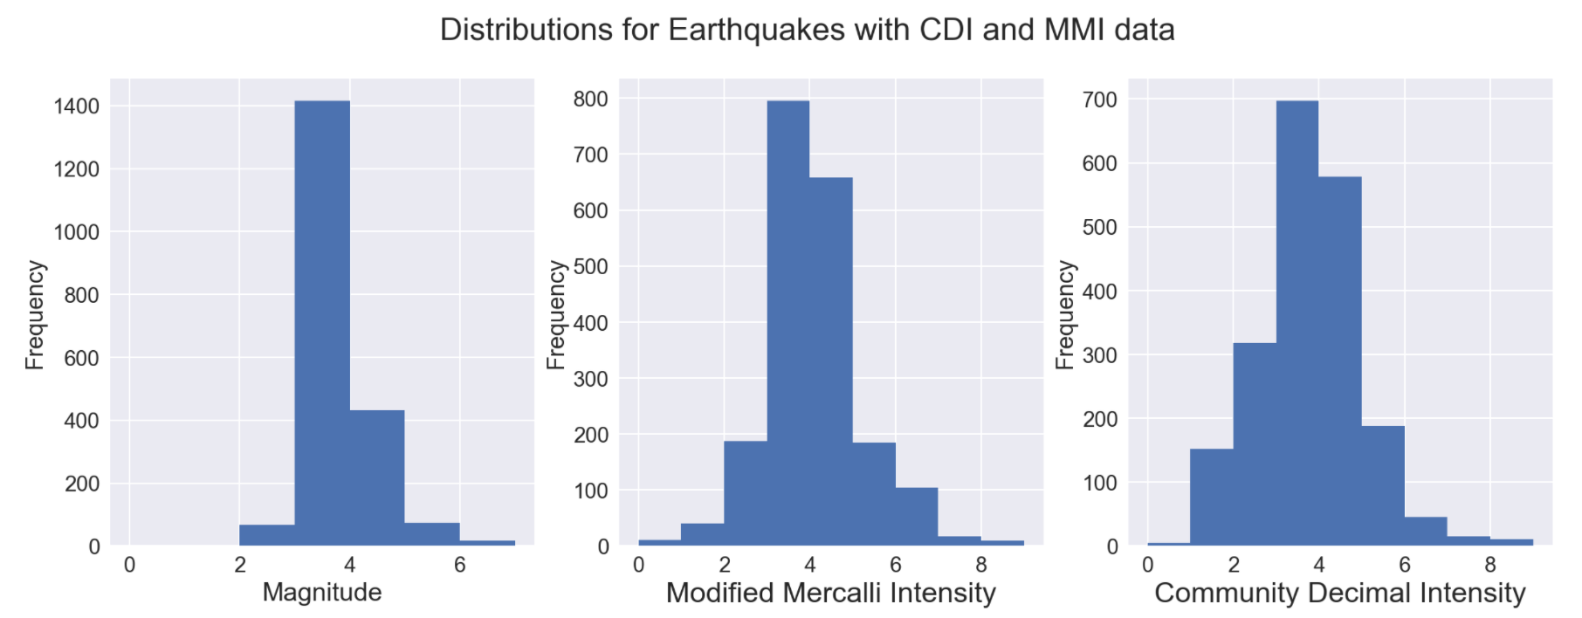
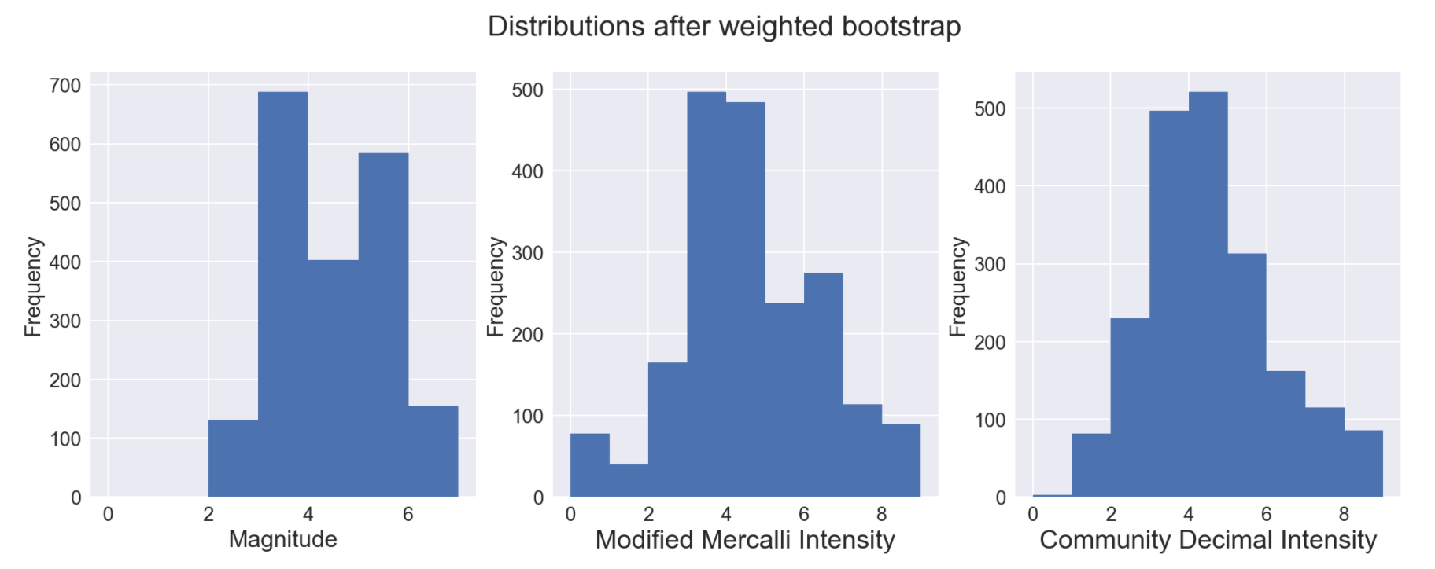
Data is not
Uniformly
distributed
Data from EQ Catalog (not DYFI)
There is a Problem:
Many small earthquakes
Few large earthquakes
MMI not determined for small quakes
And a Bigger Problem:
CDI intensities are seemingly lower in intensity than MMI intensity
Either reporters are reluctant to report more significant effects, or
Process for calculating CDI from DYFI reports is flawed

Slide 10
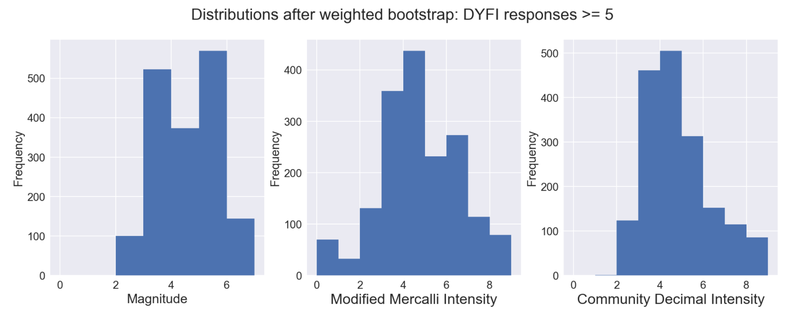
Weighted bootstrap
Generate Pseudo Random Number (prn)
Select next sample
If prn > category weight, append sample to bootstrap data, else discard (with replace)
Repeat until new bootstrap is same length as original dataset
Weights:
Mag <= 3 0.75
Mag <= 4 0.95
Mag <= 5 0.9
Mag <= 6 0.1
else 0

Slide 11
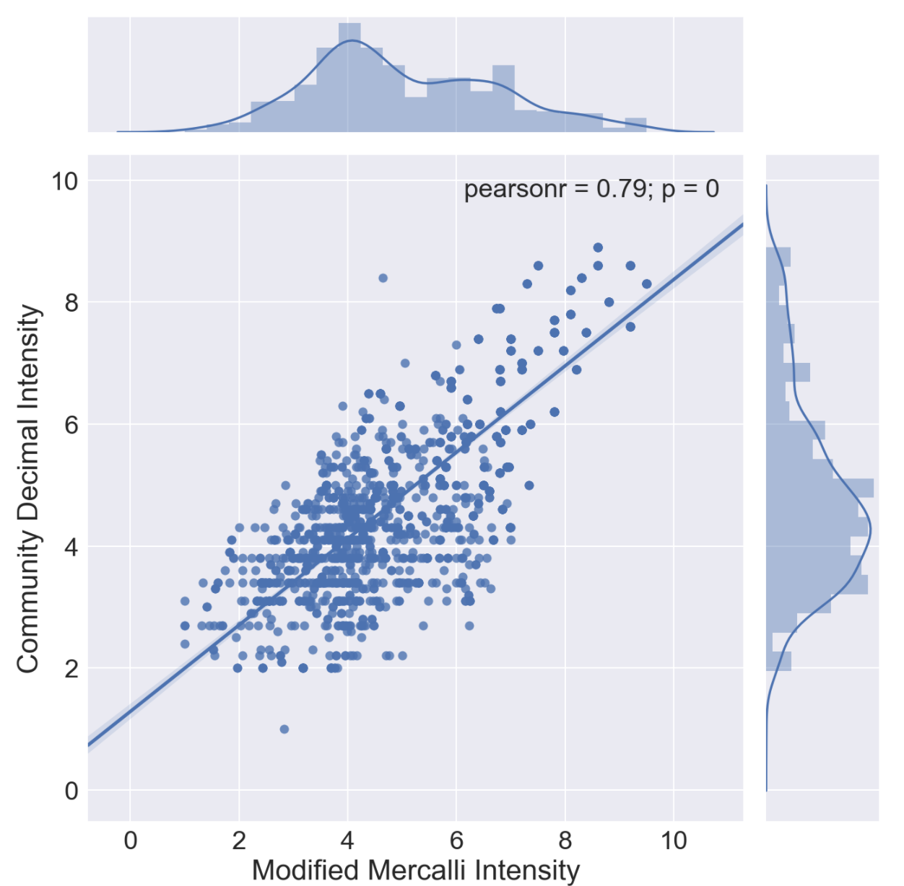
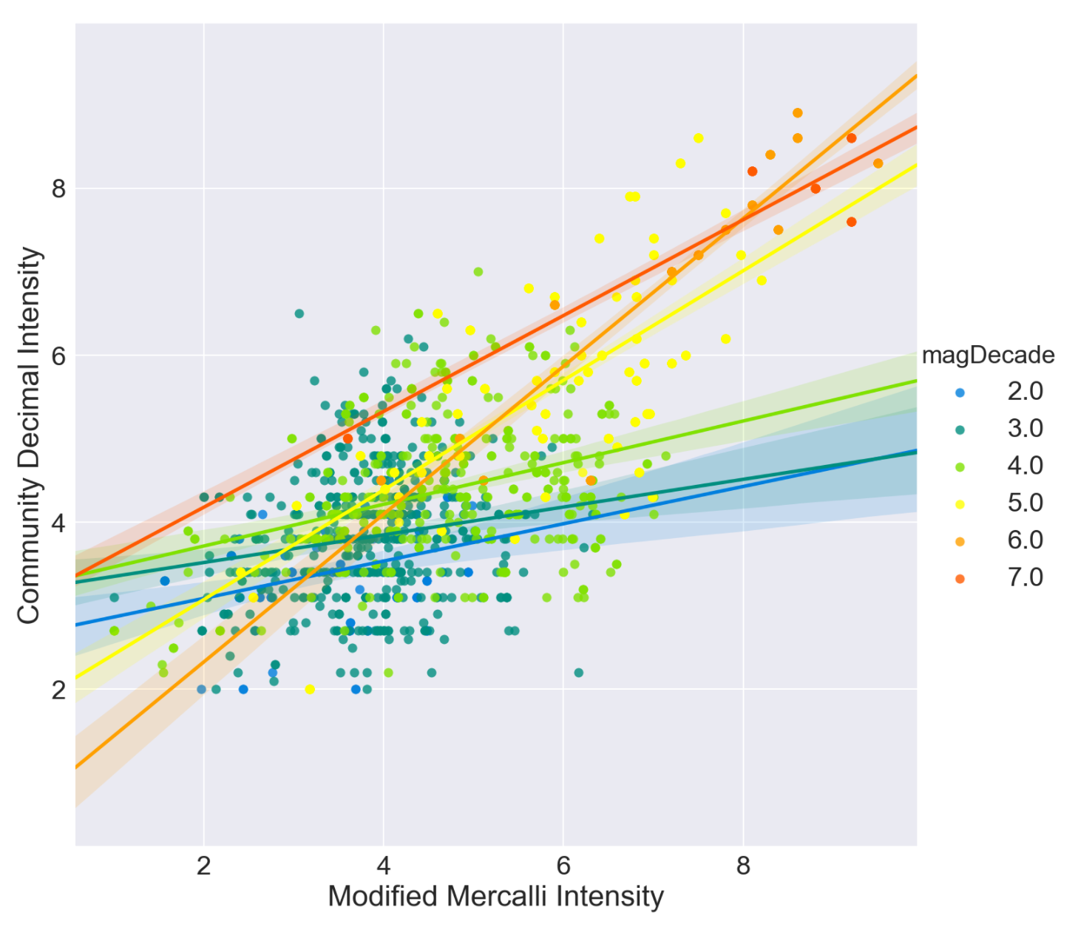
CDI / MMI comparison
Can one predict the other?
Maximum Intensity Data

Slide 12
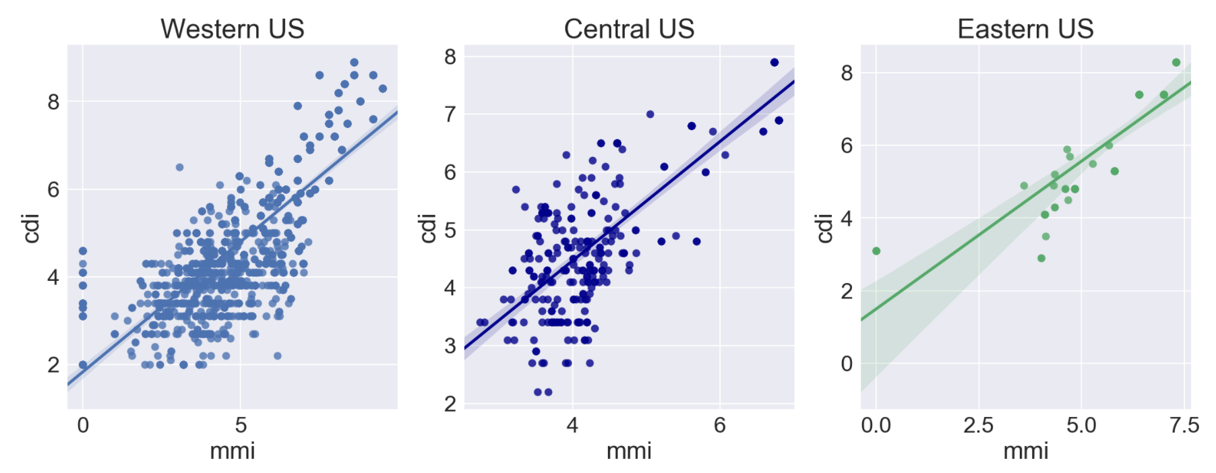
Regional Differences

Slide 13
Predict ”Expert” MMI from “Citizen” CDI
Method: Classification Models
Convert MMI to Integer Numbers
11 prediction classes [0 1 2 3 4 5 6 7 8 9 10]
Bootstrap with weighting to increase large quakes
Use additional information:
US Region: West, Central, East
Depth of earthquake
Number of DYFI reports (many are better than one)
Modeling Path
Logistic Regression
CV with Bucket of Classifiers (Random Forest best)
Random Forest alone
Gridsearch for best Random Forest depth
Decision Tree to build tree for explanation
Add more factors and repeat
Logistic Regression for first pass
Gridsearch for best strength and penalty type
Determine list of contributing factors
CV with Bucket of Classifiers (Gradient Boost best)
Gridsearch for best tree depth

Slide 14
Classification Models | Accuracy Score | Y vs Predicted Pearson R
Logistic Regression on CDI, depth, # CDI reports, US Region, C=1, pen=l2 | 0.449 | 0.76
CV with Suite of Classifiers: Random Forest was best | 0.789
Random Forest alone, using same training/test set | 0.794 | 0.94
GridSearch on depth of random forest | 0.806 | 0.93
Decision Tree (run just to get tree graph for explanatory chart) | 0.634
LR with additional features (hour of day, crust thickness and density, reporting station, magnitude calculation details) | 0.652 | 0.91
LR with GridSearch on expanded factors (C=14.51, Lasso) | 0.675 | 0.93
CV with Suite of Classifiers using expanded factors: Gradient Boost | 0.854
Gradient Boost alone, using expanded factors and same training/test set

Slide 15
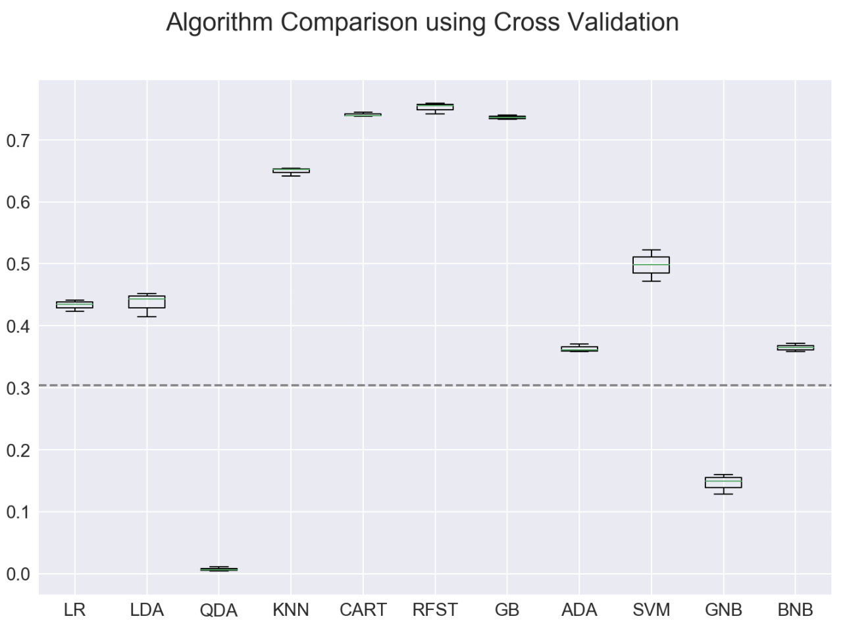
Predict MMI from CDI
Basic Factors
Random Forest 0.79
Classifiers Employed
LR: LogisticRegression()
LDA: LinearDiscriminantAnalysis()
QDA: QuadraticDiscriminantAnalysis()
KNN: KNeighborsClassifier()
CART: DecisionTreeClassifier()
RFST: RandomForestClassifier()
GB: GradientBoostingClassifier()
ADA: AdaBoostClassifier()
SVM: SVC()
GNB: GaussianNB()
BNB: BernoulliNB()

Slide 16
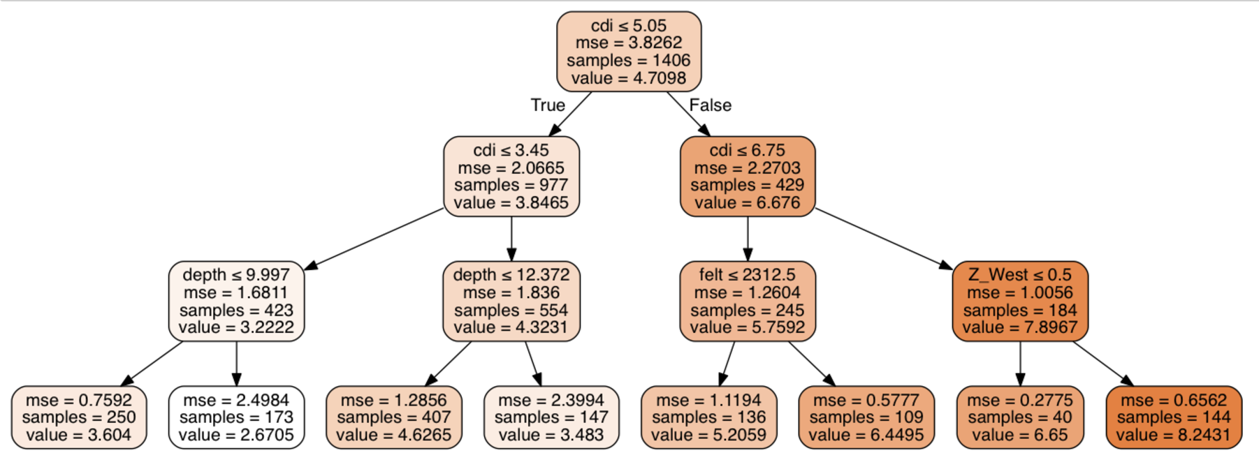
Decision Tree Selection Process
Note that CDI, Depth, Region and number of DYFI reports were all
used to make branching decisions
Random forest uses many of these
- selects random factors
- selects random samples

Slide 17
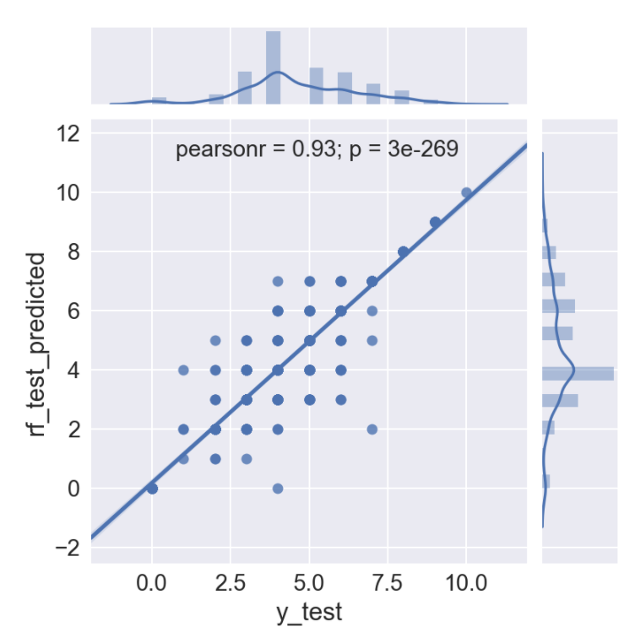
Predict ”Expert” MMI from “Citizen” CDI
Method: Random Forest
Convert MMI to Integer Numbers
Use additional information:
US Region: West, Central, East
Depth of earthquake
Number of DYFI reports
(many are better than one)

Slide 18
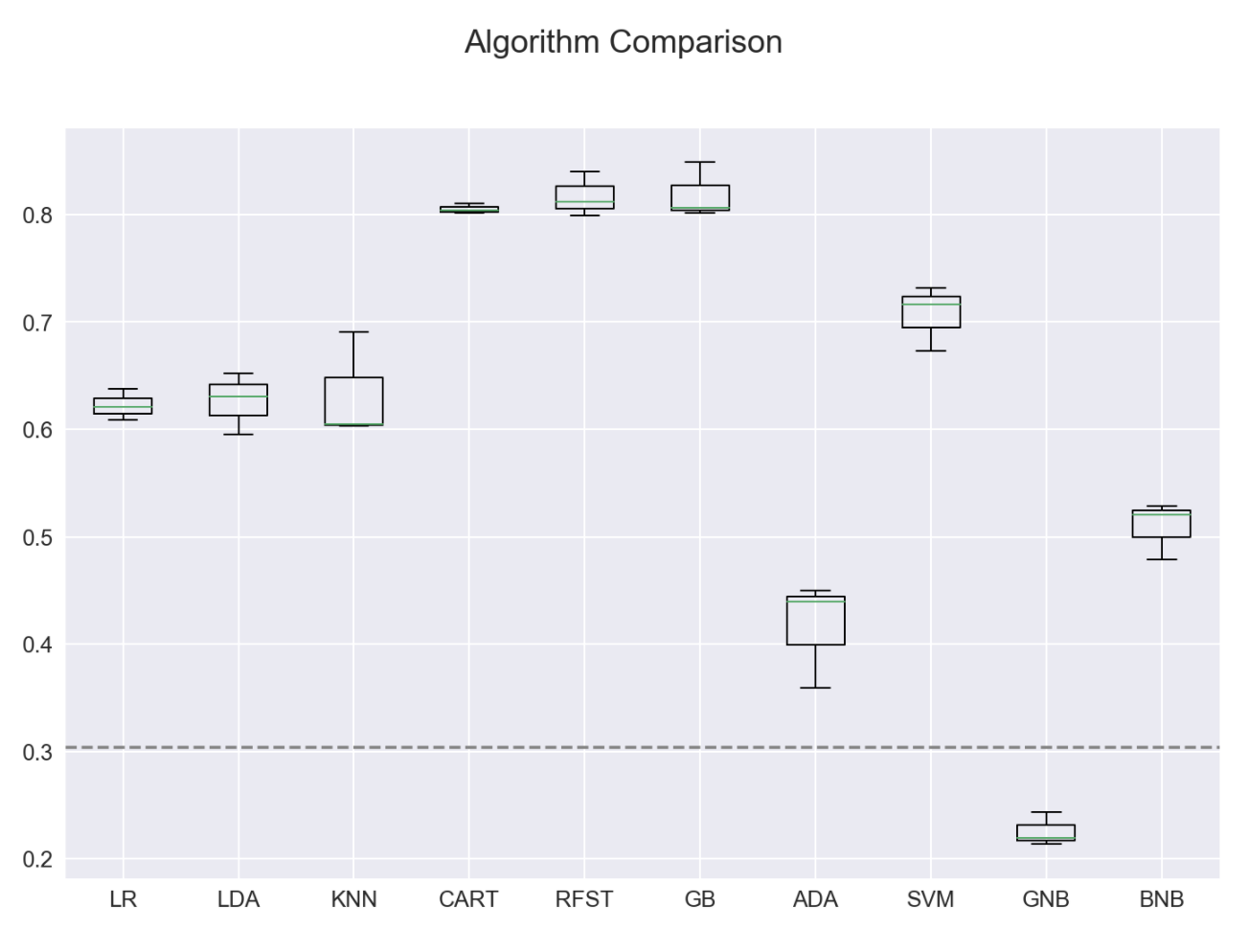
Predict MMI from CDI
Expanded Factors
Classifiers Employed
LR: LogisticRegression()
LDA: LinearDiscriminantAnalysis()
KNN: KNeighborsClassifier()
CART: DecisionTreeClassifier()
RFST: RandomForestClassifier()
GB: GradientBoostingClassifier()
ADA: AdaBoostClassifier()
SVM: SVC()
GNB: GaussianNB()
BNB: BernoulliNB()

Slide 19
Predict Intensity with Distance
Model: Multiple Linear Regression with Regularization
Data: 1206 Quakes with 55,888 DYFI ”zip codes”
Method:
Predict Community Decimal Intensity (CDI)
Predict Modified Mercalli Intensity (MMI)
Compare with published decay equations
Use traditional factors:
Distance, Magnitude
Number of DYFI reports
Use expanded factors:
Distance, Magnitude, Depth, Crust Parameters, Magnitude Calculation Method
Quakes
“DYFI” CDI
MMI
> 5

Slide 20
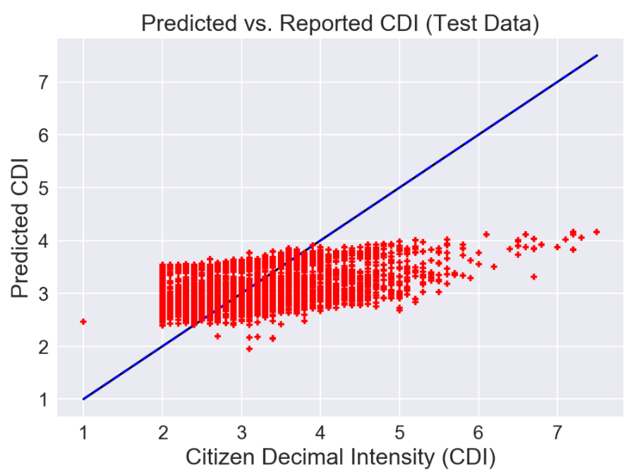
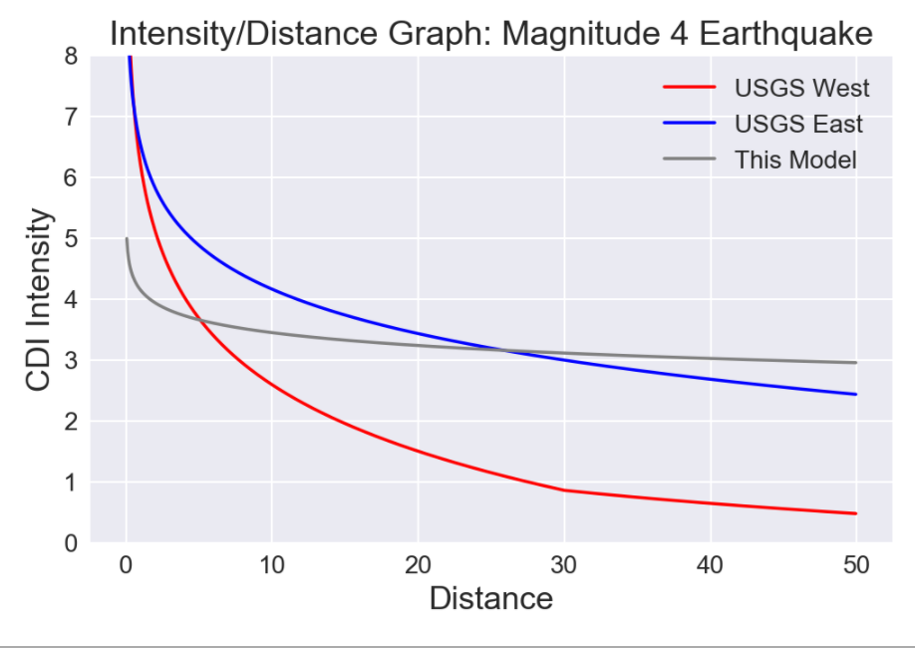
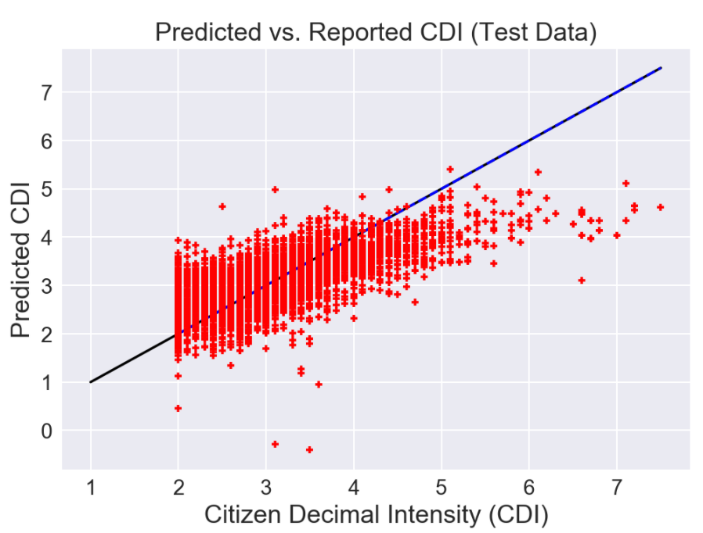
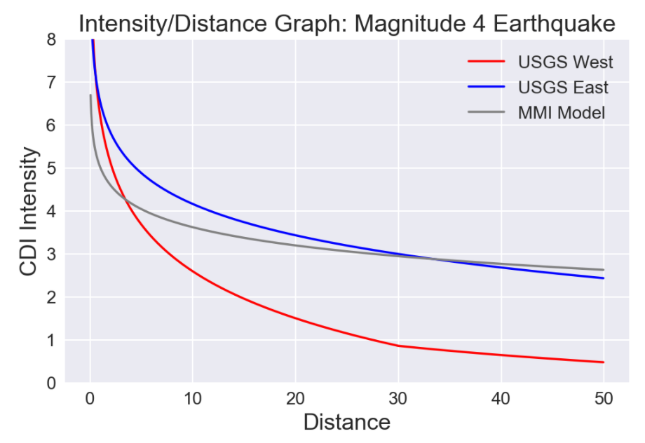
Predict CDI at Distance
R²: 18% - difference between the average CDI earthquake intensity for all observations is explained by modeling with:
Magnitude & Distance only
R²: 45% - difference between average CDI intensity of all earthquakes and what is explained by modeling with:
Magnitude and Distance and …
Depth,
Crustal Density & Thickness
Method of computing magnitude

Slide 21
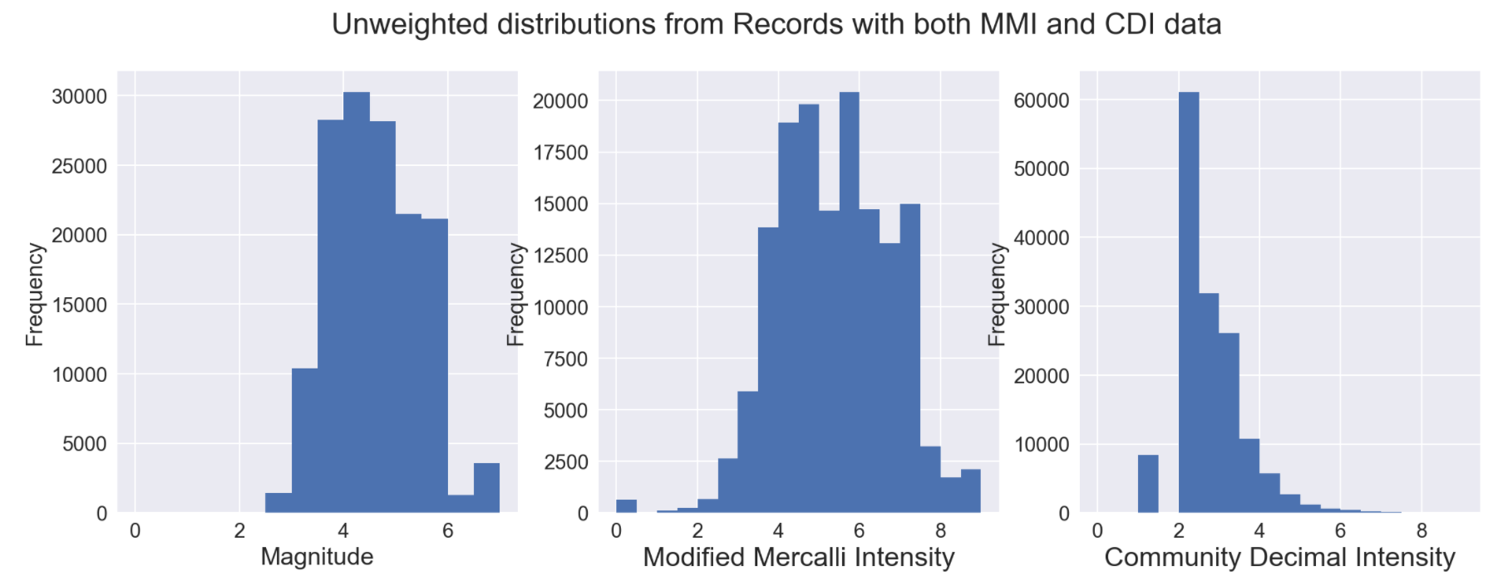
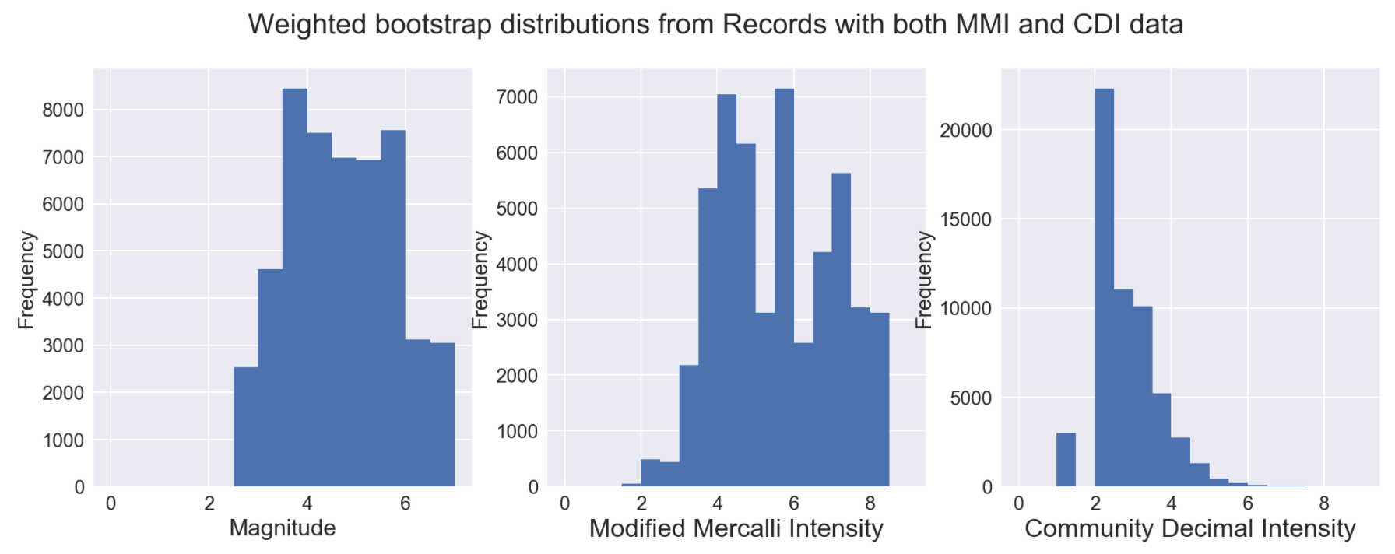
Distribution characteristics of Sample Data
Filtered to samples with
CDI
MMI

Slide 22
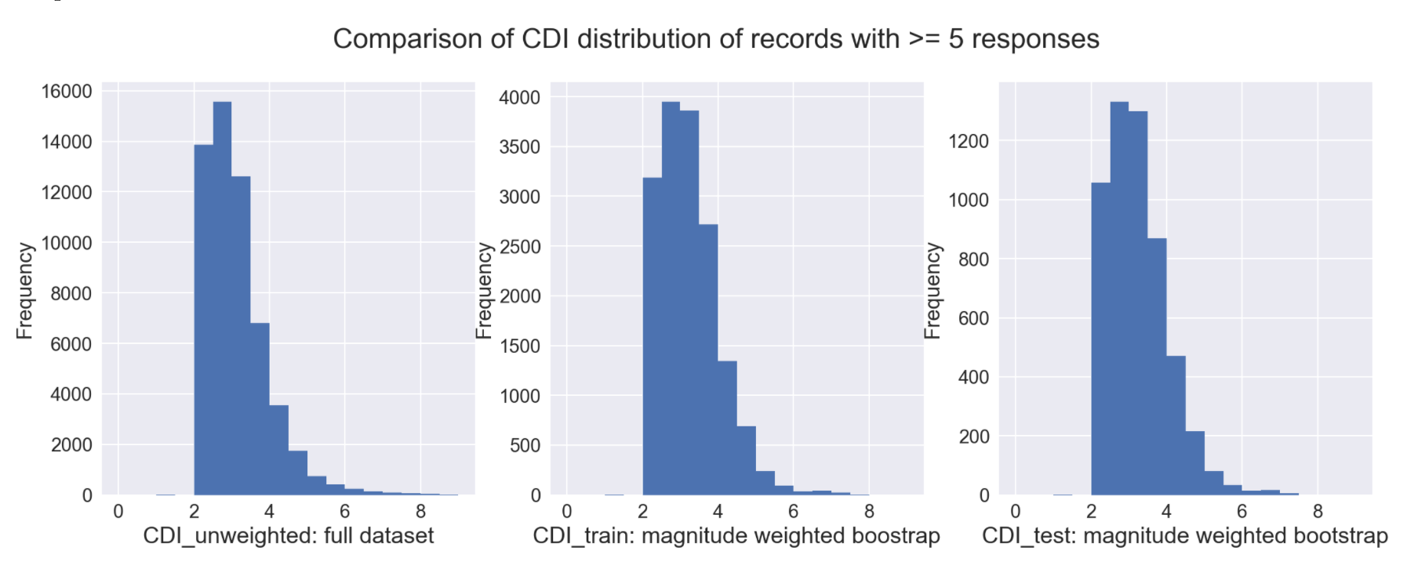
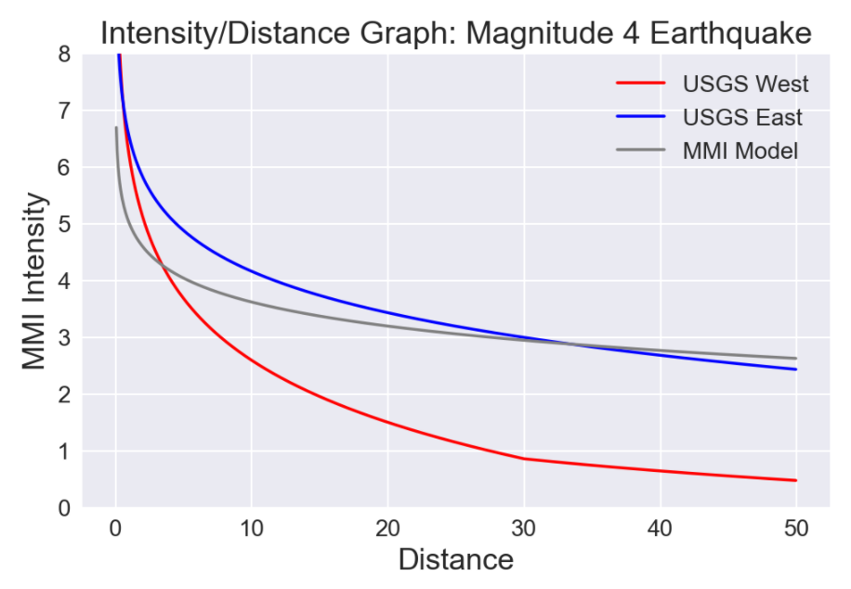
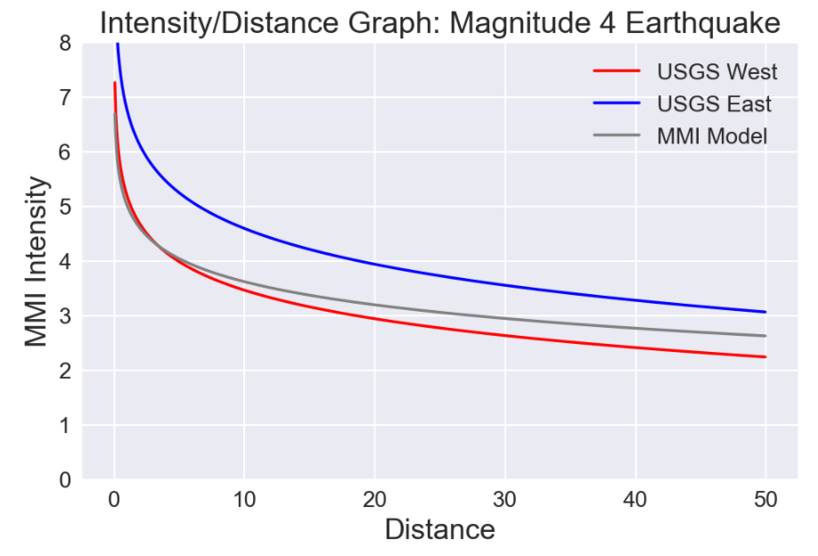
Distribution characteristics CDI Test/Train
Weighted Bootstrap filtered to samples with
CDI (with 5 or more records per quake)
MMI
Comparison with USGS MMI Curve
Interestingly, this model’s predictions align more closely with the USGS equations for predicting MMI
Possibly because additional factors draw CDI toward MMI scale?

Slide 23
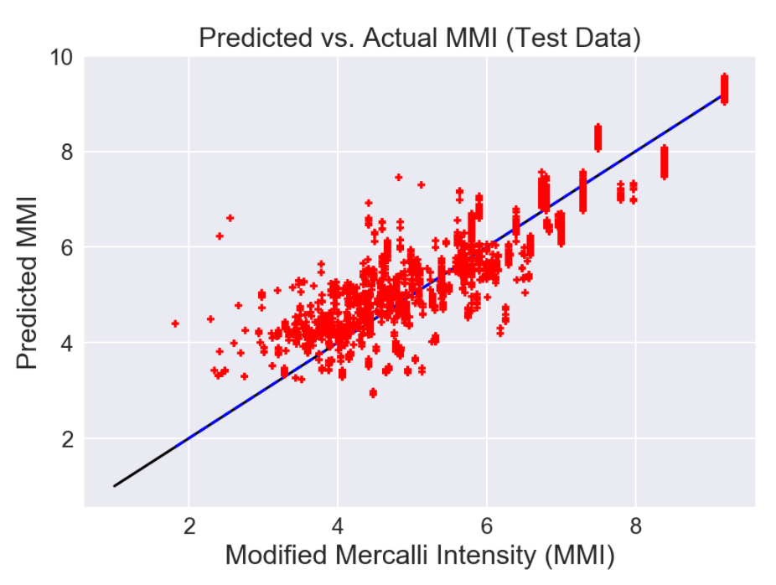
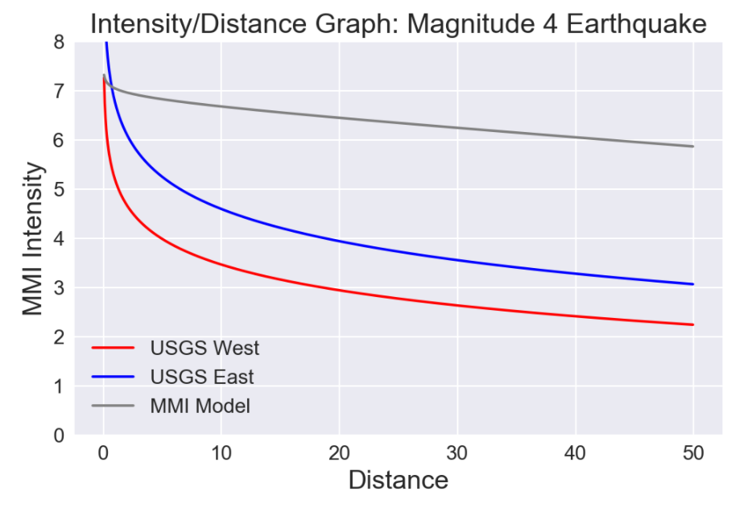
Predict MMI from
Magnitude and Distance
Modified Mercalli Intensity (MMI)
This explains 91% of the difference between average MMI intensity of all earthquakes and actual intensity observed –
… and only magnitude and distance were used!
What’s up with this?
Data reported and reviewed by experts
Reported over longer period of time
Includes larger proportion of high magnitude earthquakes

Slide 24
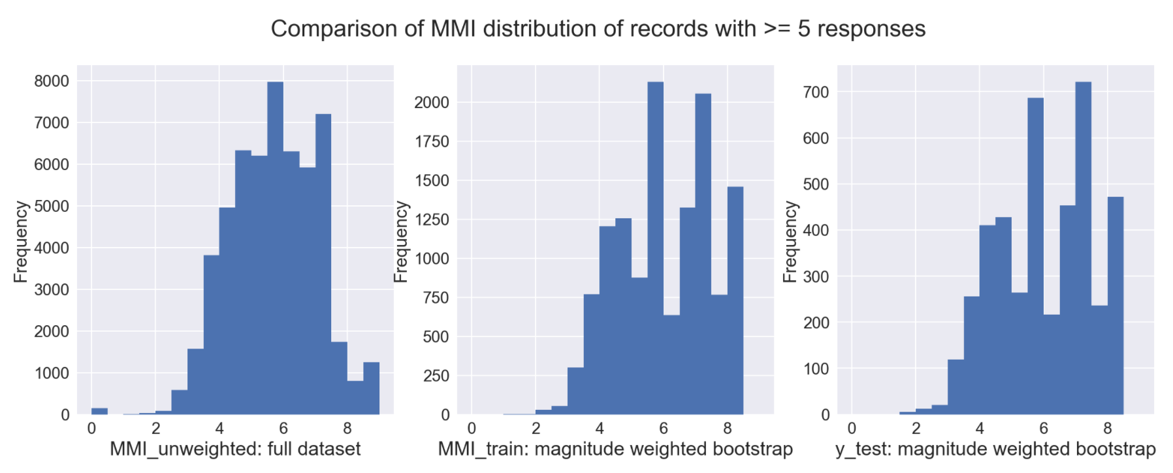
Distribution characteristics of Sample Data
Filtered to samples with
CDI (with 5 or more records per quake)
MMI

Slide 25
Data Sources
References
USGS: Common Catalog
Aggregation of Earthquake Events from many reporting agencies
Includes “Did You Feel It,” CDI data, MMI and Magnitude
LLNL: Crust 1.0 Model
Crustal Boundary and Density Data
Wald, David J. (2011). USGS “Did You Feel It?” Internet-based macroseismic intensity maps. ANNALS OF GEOPHYSICS, 54.6
Oklahoma Example: Matthew Schroyer paper
Crowdsourced Geographic Information use in Govt.

Slide 26
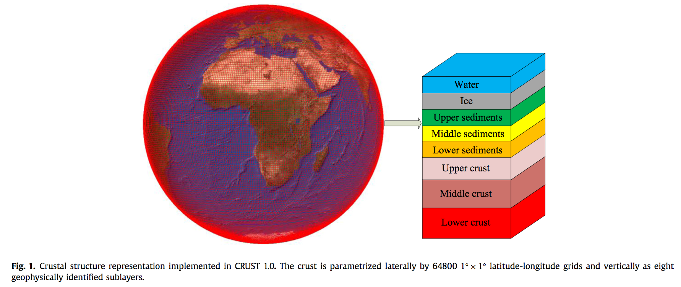
Global Crustal Model
Zhu, L.F., Pan, Z., Sun, J.Z., (2016). Visualization and dissemination of global crustal models on virtual globes, Computers and Geosciences v90, Part A, 34-40. Elsevier, https://doi.org/10.1016/j.cageo.2016.01.015
https://igppweb.ucsd.edu/~gabi/crust1.html#visualization

Slide 27
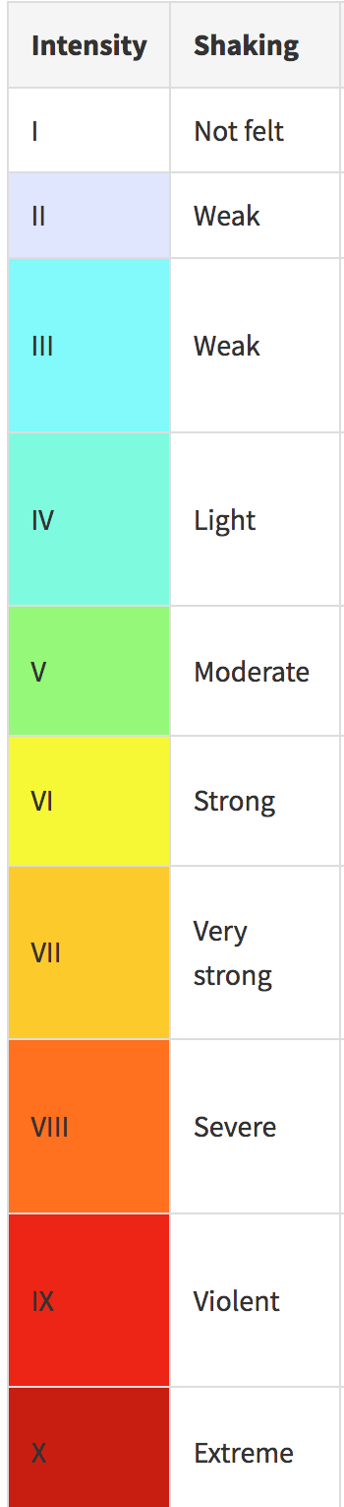
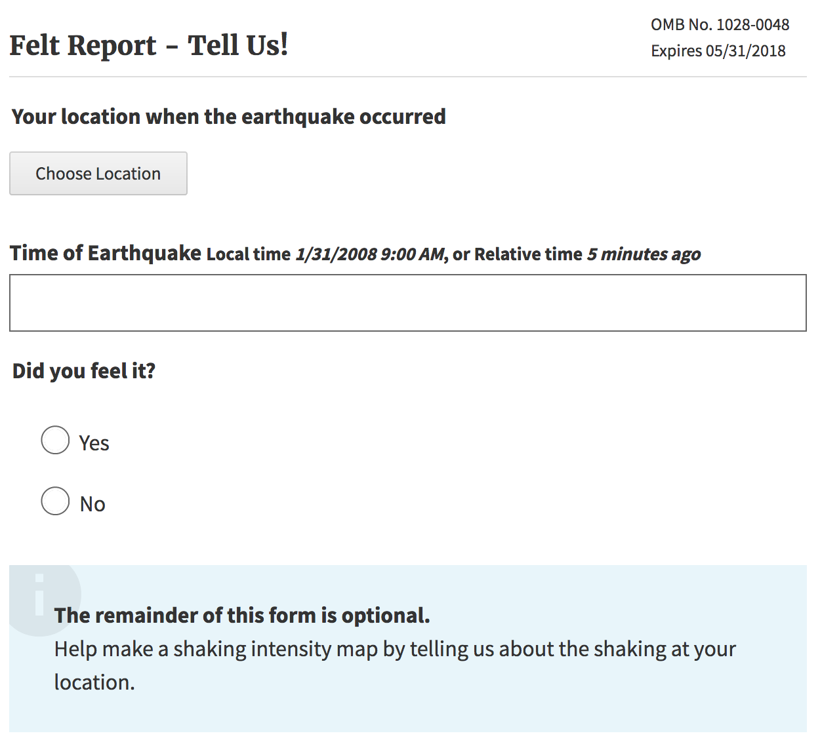
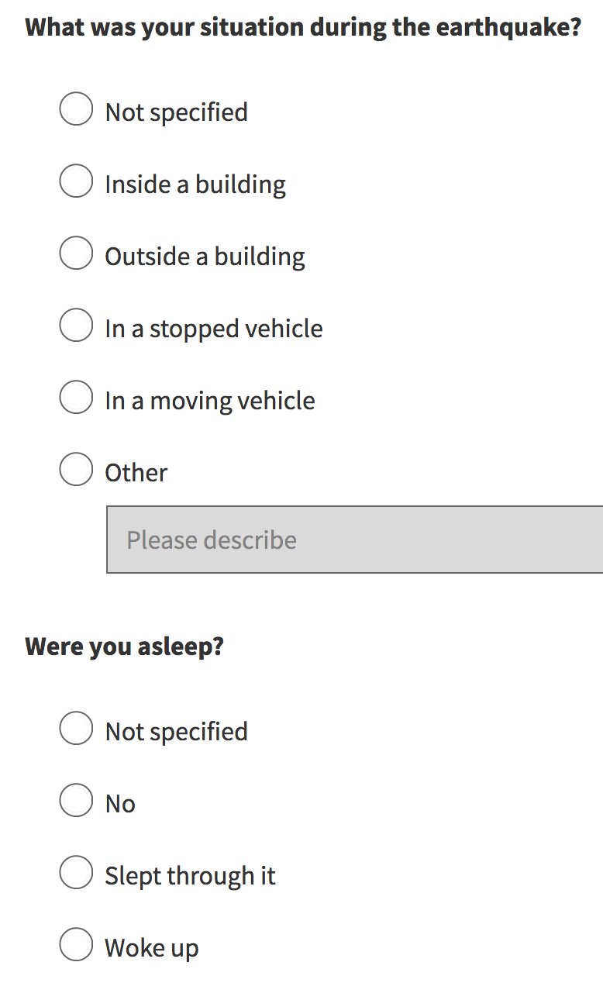
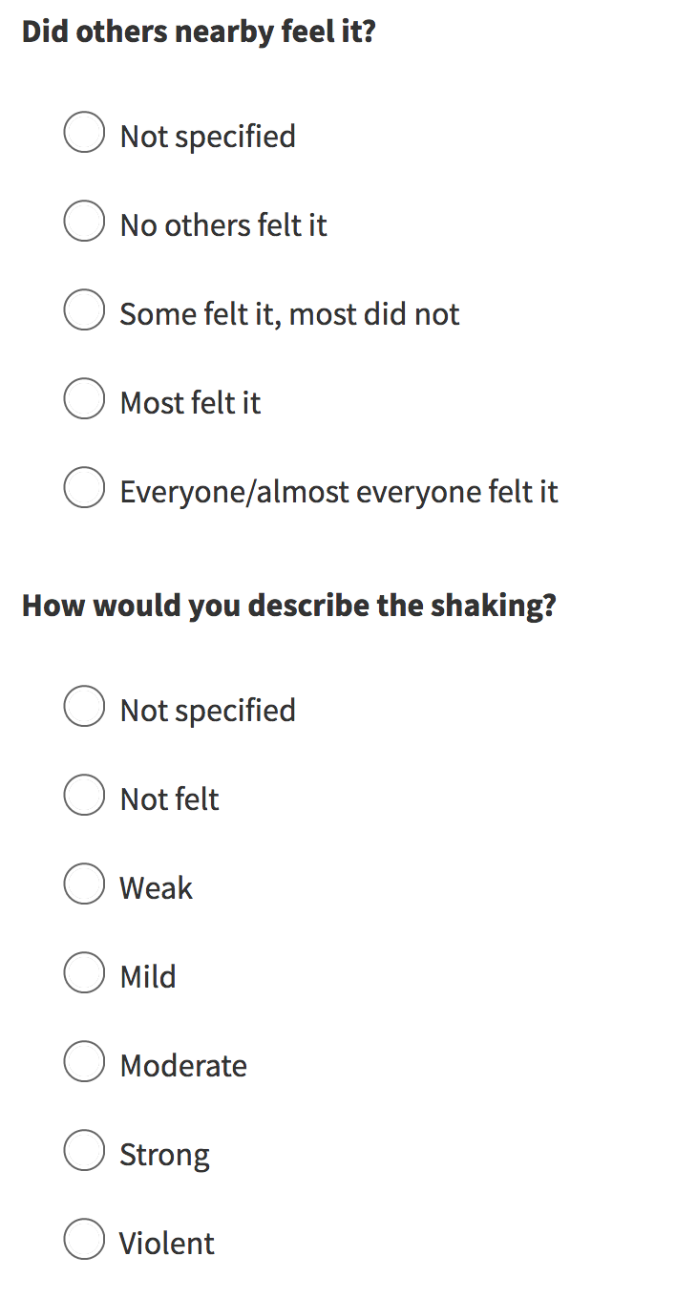
A decision tree is used to calculate CDI from
these reports. CDI = Community Decimal Intensity
Did You Feel It?
https://earthquake.usgs.gov/earthquakes/eventpage/unknown#tellus

